Slide 1
Responses to Racism
NON-RACIALISM AND BLACK CONCIOUSNESS

Slide 2
‘’We, the people of South Africa,
Believe that South Africa belongs
to all who live in it’’
Freedom Charter
26 June 1955

Slide 3
Non-racialism as emancipation
Race not as ontology but as social and historical (Suttner)
Freedom
Universalism
Humanism
Nationalism
Non-racialism warns against allowing any predicate to define “the human’’ ie. Who you are as a person
Organisation without any reference to Race. Black and White belong equally to the same organisation.
Notes:
Ontology- philosophical study of being. Of existing naturally in the world is it a ‘’thing’’
Emancipation is any effort to procure economic and social rights, political rights or equality, often for a specifically disenfranchised group
Humanism- emergence of the individual and the idea of human dignity
Nationalism –Nation to be or the nation that might be. Nation building with one national identity.
At an ontological level, it has been accepted that race does not exist. But race does have a profound presence in history and in current social relations. Historically the existence of race has been associated with oppression and the question is how it is addressed strategically

Slide 4
Non-racialism in political organising
Non-racialism refers to the rejection of racial ideology − the belief that human beings belong to different races.
It stresses the idea of one human race.
Organizationally, it implies the recruitment of individual members without regards to colour, ethnic or racial criteria.
Non-racialism has long been a subject of debate on the South African left as socialists struggled with the problems of how to organize political movements in a manner that did not reinforce state-imposed racial divisions and promote non-racialism in conditions of extreme racial inequality.

Slide 5
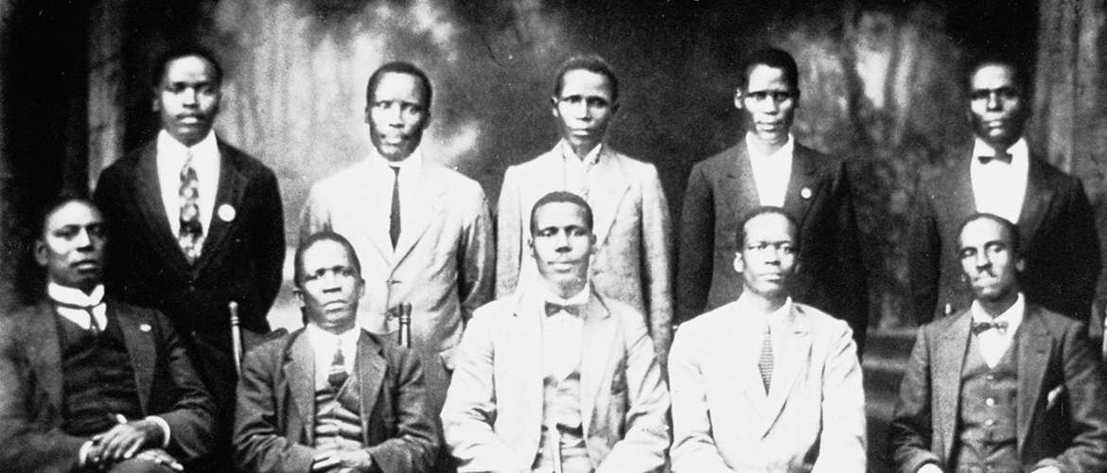
African National Congress and the Congress Alliance
Notes:
ANC started in 1912- originally by the South African Native National Conrgess only for black African Males (missionary educated) and focused on getting the vote for blacks. Founded by John Dube and Sol Plaatjie.
Congress Aliiance- Congress of Indian People and the South African Coloured People Organisation. South African Congress of Democracts (Whites). Multi-racial: accepted distinct racially organized communtiies. Broad overall Unity and an aspiration for unified society.

Slide 6
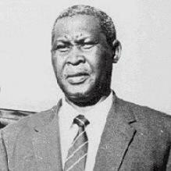
Albert Lutuli
‘’Congress believes in a common society and holds that citizens of a country, regardless of their race or colour, have the right to full participation in the government and in the control of their future’’
ANC and the SACP alliance
Comrades and Struggle heroes of all races

Slide 7
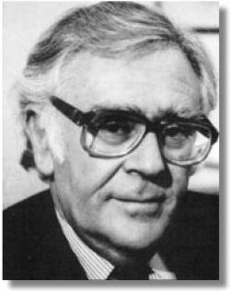
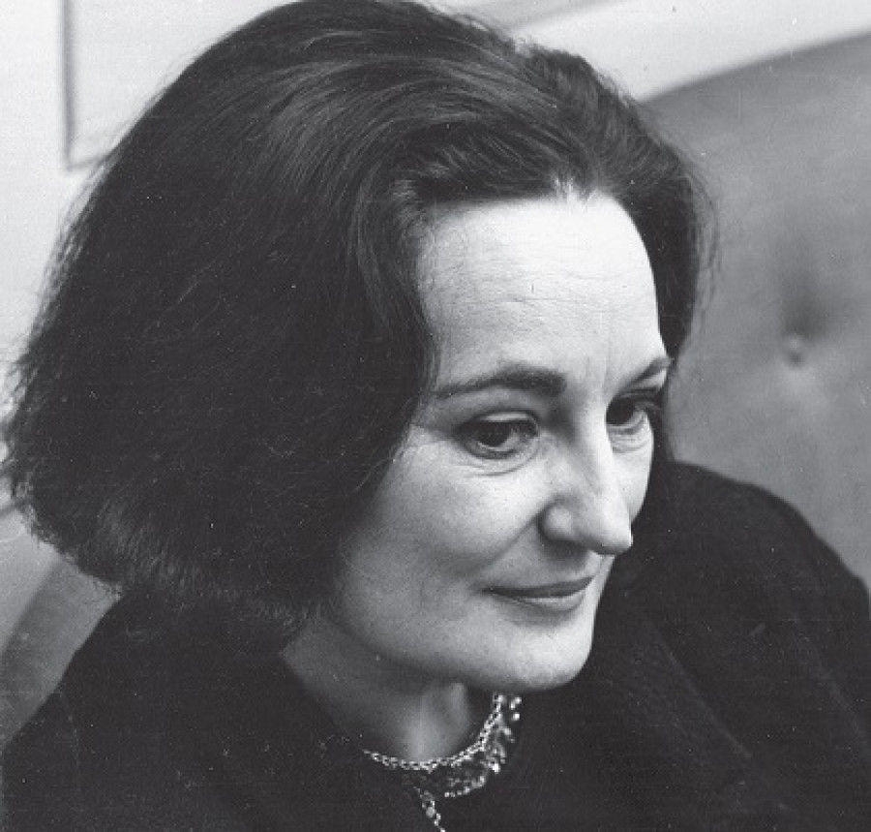
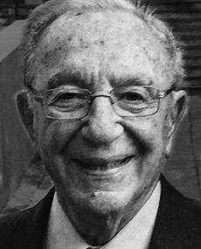
Notes:
Slovo was one of first members of the ANC MK
Active member of the SACP
Contributed to drafting the freedom charter
1985 Slovo was first white member of ANC executive
Ruth First- 1961 she was detained in the Wits university library. Kept in solitary confinement- 90 day clause.
17 August 1982, First was killed by a letter bomb, widely believed to have been the work of security agencies within South Africa. Until her death, she remained a ‘listed’ communist and could not be quoted in South Africa.
Ben Turok- leading member of Congress of Democrats
He was arrested for treason in 1956 and stood trial until charges against him were withdrawn in 1958
‘’I am not a white revolutionary I am just a revolutionary’’

Slide 8
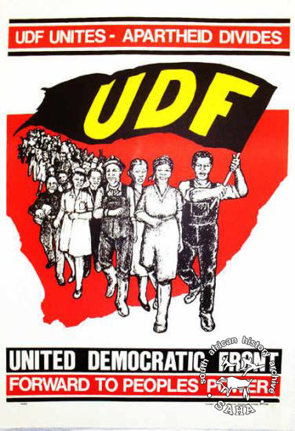
United Democratic Front
1983- 600 civil society groups come together
Committed to non-racialism as a strategy
Resisted the 1983 constitution that offered Coloured and Indian Folks a vote but excluded black folk
Notes:
After its formation, the UDF declared it wanted to establish a true democracy in which all South Africans could participate and create a single, non-racial, unfragmented South Africa.
The UDF was non-racial in the sense that it welcomed support from members of all races. Although it permitted group mobilization based on a specific ethnicity, the overall aim remained the achievement of a non-racial society. The dominant political characteristic of the UDF was that most of its affiliated members supported the Freedom Charter.

Slide 9
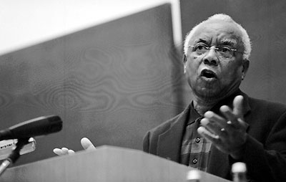
Neville Alexander
The idea of 'race' was an invention, an invention used to keep people who did not look white in a state of permanent subjection.
‘’The word 'non-racial' can be accepted by a racially oppressed people if it means that we reject the concept of race, that we deny the existence of races and thus oppose all actions, practices, beliefs and policies based on the concept of race’’
Non-racialism is the only way to overcome racial prejudice and racial attitudes
The colour of your skin said nothing about the content of your character, your intelligence or any of your capacities
Notes:
Young age coloured militancy and anti-white
Moved from eastern cape- Cradock to University of Cape Town in 1953
Though he was non-racialist he did believed in racial inequality (not just class inequality) and that we has to be reducing or illuminating racial inequality
Must not mistake non racialism for multi racialism. Non racialism is not a mixture of colours it is an attitude of mind. He gives the example of a predominately coloured school in the Cape Flats and insists that those students can still maintain non racialism

Slide 10
Crain soudien
the power of non-racial idea was useful at both a personal and a group level.
‘’At the personal level, it helped many of us come to the awareness that our dignity was unconditional. It did not depend on the identities that history sought to impose on us. We were human without qualification’’
Problematic and morally objectionable to think greater loyalty was owed to those who looked like you simply because of that – that they looked like you
’’It freed us from the conceits of superiority and the anxieties of inferiority. No longer did we need to think with our skins’’
END OF PART 1-
10 minute break
Notes:
Give context of the speech given- why he left

Slide 11
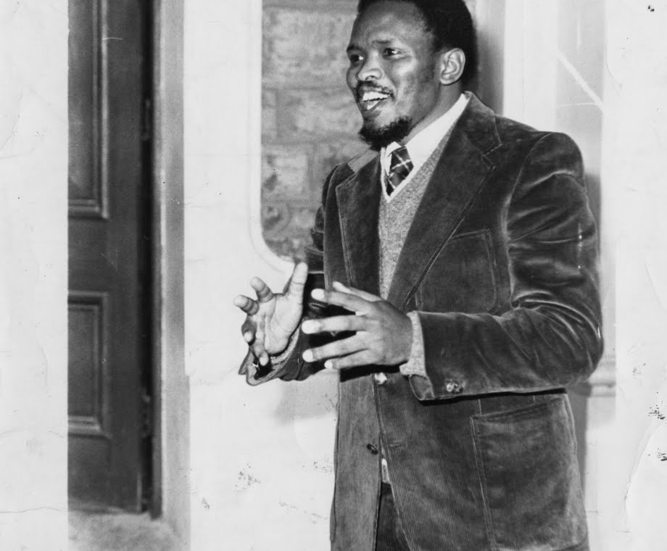
Part 2: black consciousness
“For the liberals, the thesis is apartheid, the antithesis is non-racialism… Black Consciousness defines the situation differently. The thesis is in fact a strong white racism and therefore, the antithesis to this must… be a strong solidarity amongst the blacks on whom this white racism seeks to prey. …[Then] we can hope to reach some kind of balance - a true humanity where power politics will have no place” (p. 90)
Notes:
Neville alexander describes not meeting Biko as one of the greatest tragedies of his life despite thinking BCM was racial essentialism
Important to note that this was happening at the same time as Malcolm X and Martin Luther King
Inspired by WEB Du Bois’s ‘double consciousness’ (always looking at one's self through the eyes of others) “Black Consciousness makes the black man see himself as a being complete in himself” (p. 92)

Slide 12
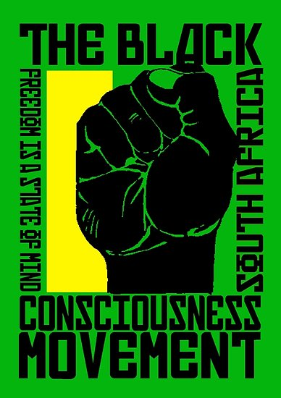
“biko black’’
defined blacks as those who are by law or tradition politically, economically and socially discriminated against as a group in the South African society
identifying themselves as a unit in the struggle towards the realisation of their aspirations.
Being black is not a matter of pigmentation - being black is a reflection of a mental attitude.
by describing yourself as black you have started on a road towards emancipation, you have committed yourself to fight against all forces that seek to use your blackness as a stamp that marks you out as a subservient being
Non-whites are those who aspire to whiteness
Notes:
operate as a group in order to rid themselves of the shackles that bind them to perpetual servitude

Slide 13
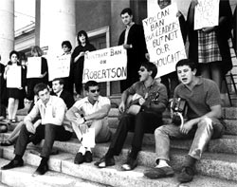
NUSAS AND THE ‘’LIBERAL WHITE’’
“Though whites are our problem, it is still other whites who want to tell us how to deal with that problem” (p. 89)
‘’… by some skillful maneuver they have managed to control the response of blacks to the provocation. Not only have they kicked the black but they have also told them how to react to the kick’’
Questioned whether white activists intentions were motivated by genuine concern or guilt
Notes:
NUSAS founded in 1924
University of Stellenbosch cut its ties from NUSAS and this completed the split between Afrikaans and English speaking universities. In 1945 University of Fort Hare became a member of NUSAS. It was only after the admission of Fort Hare and Non-White section of the University College of Natal in the 1940s that NUSAS became a non-racial organization
RMF BCM and Whites

Slide 14
South African students organisaiton rejected the notion that whites could play a role in the liberation of Blacks
1968: SASO broke away from NUSAS
dissatisfied with the inability of NUSAS to tackle deep racist structures and policies of both the government and universities
Formation of Black Theology and University Christian movement (1967)
The aim of black theology was to teach that blackness and inferiority was not a punishment nor a condition created by God
Notes:
1967 Biko attended a conference of students that was critical of the government. Primarily because NUSAS was dominated by whites, Rhodes University, the conference host, refused to allow mixed-race accommodation or eating facilities.
Dismissed talk of liberalism as an empty gesture by Whites who really wished to maintain the status quo and keep Blacks as second-rate citizens.

Slide 15
True integration
‘’Does this mean that I am against integration? If by integration you understand a breakthrough into white society by blacks, an assimilation and acceptance of blacks into an already established set of norms and code of behaviour set up by and maintained by whites, then YES I am against it. I am against the superior-inferior white- black stratification that makes the white a perpetual teacher and the black a perpetual pupil (and a poor one at that). I am against the intellectual arrogance of white people that makes them believe that white leadership is a sine qua non in this country and that whites are the divinely appointed pace-setters in progress. I am against the fact that a settler minority should impose an entire system of values on an indigenous people’’

Slide 16
‘’If on the other hand by integration you mean there shall be free participation by all members of a society, catering for the full expression of the self in a freely changing society as determined by the will of the people, then I am with you. For one cannot escape the fact that the culture shared by the majority group in any given society must ultimately determine the broad direction taken by the joint culture of that society. This need not cramp the style of those who feel differently but on the whole, a country in Africa, in which the majority of the people are African must inevitably exhibit African values and be truly African in style."

